Slide 1

AMAZON WEB SERVICES(AWS)
MODULE 5
Presentation Material
Department of Computer Science & Engineering
Course Code: 21CS4708 |  | Semester: VII
Course Title: | AMAZON WEB SERVICES(AWS) | Year: IV
Faculty Name: | Dr. Gokulakrishnan S

Slide 2
MODULE 5: Contents
DNS, Network Routing, SQS: The Domain Name System, Amazon Route 53, Amazon CloudFront, AWS CLI Example, Simple Queue Service -Queues, Types, Polling, Dead letter queues, Kinesis – Video streams, Data Streams, Data Firehouse, Kinesis Data Firehose vs. Kinesis Data Streams.
Textbook 1: Chapter 8: 211-225, Chapter 9:233-239

Slide 3
AWS Route 53 is one of the most popular and widely used services of Amazon Web Services. This is generally because it is highly available, reliable, and flexible for the customer/users.
Amazon Route 53 is a highly efficient and scalable cloud web service and is also used for the health checking of resources. It provides developers with an efficient and extremely reliable way to connect users to internet applications without any downtime, it still has downtime in servers or applications but users/customers may not be aware of it. It effectively connects user requests to AWS such as Amazon EC2 instances, Elastic Load Balancing, or Amazon S3 buckets. AWS Route 53 mainly performs three functions:-
It registers the name for the website (Domain name) which needs a name. Like if you want to buy a domain name, you that domain name through Route 53.
It helps the user to connect the website or web application with the browser in the server when he/she enters the website name.
It keeps checking the health of resources before the customer notices it by sending an automated request over the internet to resources.

Slide 4
Benefits Of Using Amazon Route 53
Highly efficient and reliable ensures a consistent ability to route applications.
It can handle millions of millions of requests because it is highly scalable.
It can handle large queries without user interaction.
It’s very easy to use, to sign up for, and configure and provides fast responses.
It’s very cost-effective like paying only for the services you used.
It’s very secure, because of Identity and Access Management (IAM).

Slide 5
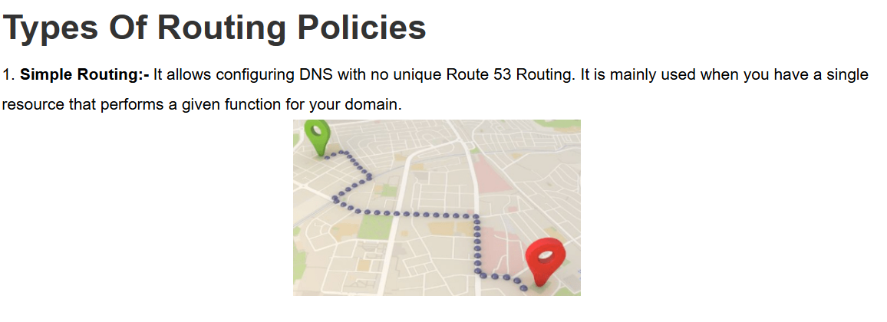

Slide 6
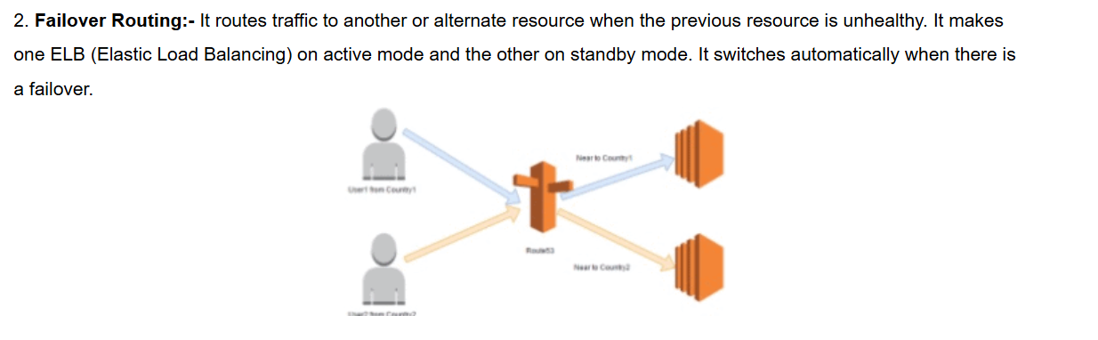

Slide 7
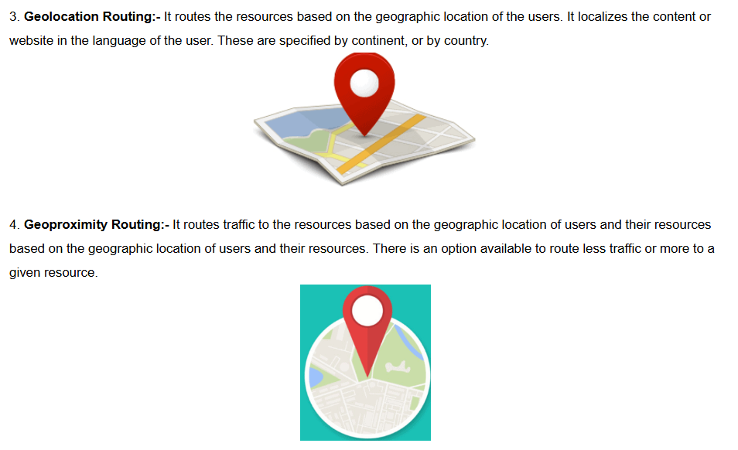

Slide 8
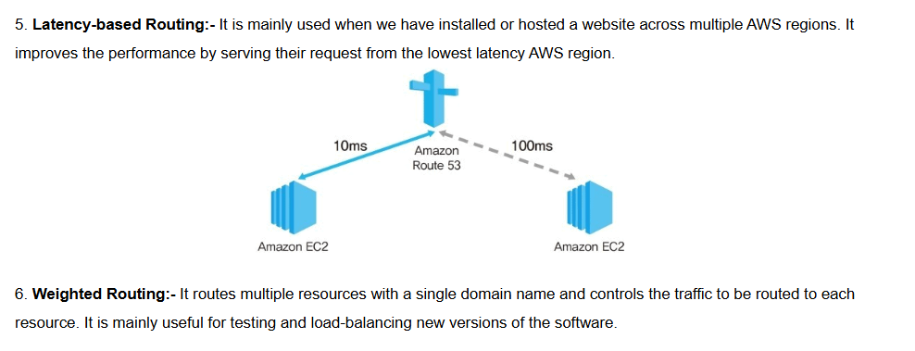

Slide 9
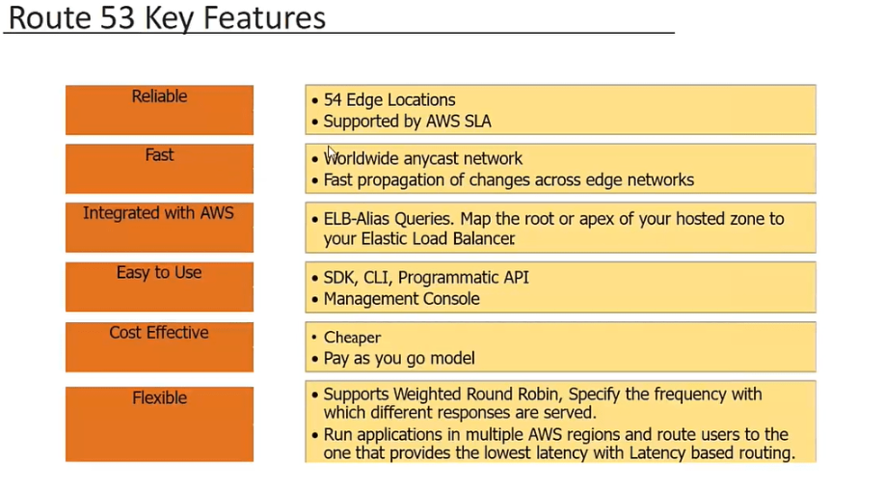

Slide 10
Steps To Configure Amazon Route 53
https://k21academy.com/amazon-web-services/aws-solutions-architect/aws-route-53/

Slide 11
What is AWS CloudFront?
AWS CloudFront is a globally-distributed network offered by Amazon Web Services, which securely transfers content such as software, SDKs, videos, etc., to the clients, with high transfer speed.
Benefits of AWS CloudFront
It will cache your content in edge locations and decrease the workload, thus resulting in high availability of applications.
It is simple to use and ensures productivity enhancement.
It provides high security with the ‘Content Privacy’ feature.
It facilitates GEO targeting service for content delivery to specific end-users.
It uses HTTP or HTTPS protocols for quick delivery of content.
It is less expensive, as it only charges for the data transfer.

Slide 12
How Does AWS CloudFront Work? https://www.simplilearn.com/tutorials/aws-tutorial/aws-cloudfront
How to Create a Distribution Network for CloudFront? https://www.simplilearn.com/tutorials/aws-tutorial/aws-cloudfront

Slide 13
Amazon Web Services – Simple Queue Service(SQS)
SQS enables web service applications that help to quickly and reliably queue messages. These messages have one component in their application that generates only when to be consumed by another component. Therefore, the queue is a temporary repository for messages and these messages are awaiting processing. So, Once these messages are processed, the messages also get deleted from the queue. AWS SQS service basically adds messages in a queue and then, Users will pick up these messages from the queue. A queue is a place where you can store your messages until they are extracted from the queue or expired.

Slide 14
Amazon Web Services – Simple Queue Service(SQS)
What is Full Form Of Amazon SQS?
The full form of “Amazon SQS is Simple Queue Service”. It is fully managed by AWS it’s self it will take care of all the aspects like hardware provisioning, maintenance, and scaling. AWS SQS provides communication in a distributed system or application. The applications which are running in the cloud will be distributed across the different servers they need to communicate with each other.

Slide 15
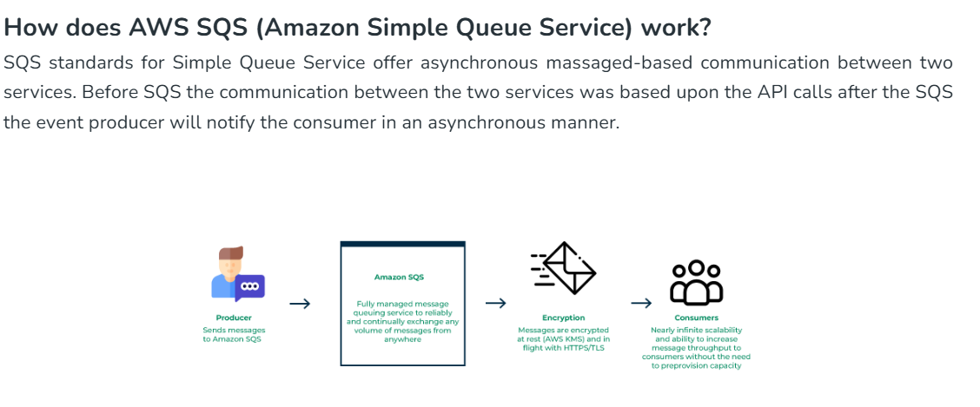
Amazon Web Services – Simple Queue Service(SQS)

Slide 16
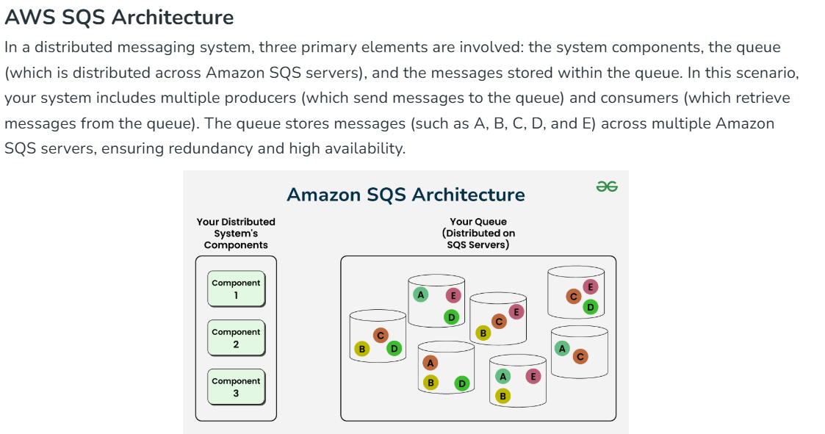
Amazon Web Services – Simple Queue Service(SQS)

Slide 17
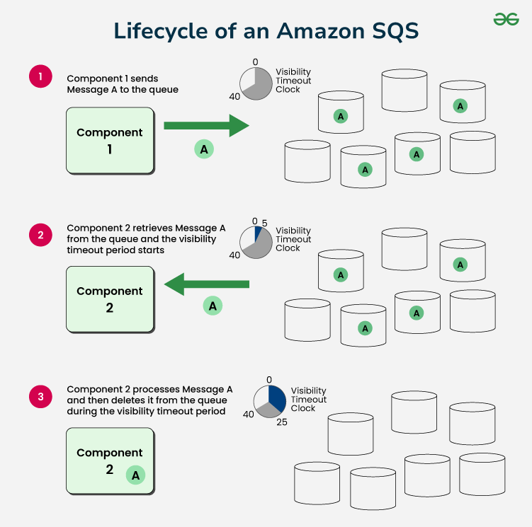
Amazon Web Services – Simple Queue Service(SQS)

Slide 18
Amazon Kinesis Data Streams and Amazon Data Firehose
Amazon Kinesis Data Streams and Amazon Data Firehose are both services for handling real-time streaming data, but they differ in their purpose, flexibility, and management:
Purpose
Kinesis Data Streams is better for real-time data processing with custom logic, while Kinesis Data Firehose is better for streaming data to other AWS services or third-party services.
Flexibility
Kinesis Data Streams offers more flexibility and control for complex processing needs.
Management
Kinesis Data Firehose provides a simpler, fully managed solution for direct data delivery.
Features
Kinesis Data Streams is serverless, highly available, and durable. Kinesis Data Firehose is secure, scales elastically, and offers pay-as-you-go pricing.

Slide 19
Amazon Kinesis Data Streams and Amazon Data Firehose
Here are some other differences between the two services:
Customization: Kinesis Data Streams is highly customizable and best suited for developers building custom applications.
Integration: Kinesis Data Streams integrates with other AWS services.
Latency: Kinesis Data Streams is a low latency streaming service.
Throughput: Kinesis Data Streams offers dedicated throughput per consumer.
Capacity mode: Kinesis Data Streams offers on-demand and provisioned capacity mode.

Slide 20
